Slide 2
PRESENTATION OVERVIEW
UNDERSTANDING BUSINESS PROBLEM
BUSINESS INSIGHT AND OBJECTIVE
EXPLORATORY DATA ANALYSIS
MODELS FOR PROBLEM SOLVING
MODEL BUILDING
MODEL TUNING
MODEL EVALUATION AND VALIDATION
ANALYSIS INSIGHTS
MODEL INTERPRETATION
BUSINESS RECOMMENDATIONS FOR WIN STRATEGY (TEST:1; ODI:2; T20:2)

Slide 3
UNDERSTANDING PROBLEM STATEMENT
External analytics consulting firm was hired by BCCI for data analytics of Sports data. The sports data set with the information of games played previously were provided to develop strategies for winning cricket game by Indian cricket team.
BUSINESS INSIGHT
Cricket is liked by most of the people across the globe and has a huge finance involved in organising them. In turn, the BCCI should also earn profits by organising them. The BCCI with the winning strategies and recommendations provided by the analysed data of the past games played, can be used to train Indian team so that the Indian team can have a better win and in turn have profits for the BCCI from the tickets sold to audience, advertising companies, promotions for products, parking payments etc.
There is rapid expansion of sports data analytics every year. Technological advances in development of different machine learning models, evaluating models have gained insight to formulate strategies for sports so that chances of win can be increased or achieved.

Slide 4
OBJECTIVE
To propose different win strategies for Indian cricket to be played in various formats i.e., Test (1 strategy), ODI (2 strategies), T20 (2 strategies) for INDIAN CRICKET TEAM WIN. The strategies are to be provided for matches played in India against Sri Lanka (ODI), Australia(T20) during winter season as day and night matches and for test match to be played against England in England as day match in rainy season.
Data Set given: ‘Sports Data.xlsx’
Target Variable: Result

Slide 5
DESCRIPTIVE STATISTICS OF CONTINUOUS VARIABLES
Numerical variables | count | mean | std | min | 25% | 50% | 75% | max
Avg_team_Age | 2833 | 29.24 | 2.26 | 12 | 30 | 30 | 30 | 70
Bowlers_in_team | 2848 | 2.91 | 1.023 | 1 | 2 | 3 | 4 | 5
Wicket_keeper_in_team | 2930 | 1 | 0 | 1 | 1 | 1 | 1 | 1
All_rounder_in_team | 2890 | 2.72 | 1.09 | 1 | 2 | 3 | 4 | 4
Audience_number | 2849 | 46267.96 | 48599.58 | 7063 | 20363 | 34349 | 57876 | 1399930
Max_run_scored_1over | 2902 | 15.19 | 3.66101 | 11 | 12 | 14 | 18 | 25
Max_wicket_taken_1over | 2930 | 2.713993 | 1.080623 | 1 | 2 | 3 | 4 | 4
Extra_bowls_bowled | 2901 | 11.252671 | 7.780829 | 0 | 6 | 10 | 15 | 40
Min_run_given_1over | 2930 | 1.95256 | 1.678332 | 0 | 0 | 2 | 3 | 6
Min_run_scored_1over | 2903 | 2.762659 | 0.705759 | 1 | 2 | 3 | 3 | 4
Max_run_given_1over | 2896 | 8.669199 | 5.003525 | 6 | 6 | 6 | 9.25 | 40
extra_bowls_opponent | 2930 | 4.229693 | 3.626108 | 0 | 2 | 3 | 7 | 18
player_highest_run | 2902 | 65.889387 | 20.331614 | 30 | 48 | 66 | 84 | 100

Slide 6
DESCRIPTIVE STATISTICS OF CATEGORICAL VARIABLES
Categorical Varibales | count | unique | top | freq
Game_number | 2930 | 2930 | Game_799 | 1
Result | 2930 | 2 | Win | 2457
Match_light_type | 2878 | 3 | Day | 2041
Match_format | 2860 | 4 | ODI | 1865
First_selection | 2871 | 3 | Bowling | 1722
Opponent | 2894 | 9 | South Africa | 640
Season | 2868 | 3 | Rainy | 1309
Offshore | 2866 | 2 | No | 2057
Players_scored_zero | 2930 | 5 | 3 | 1730
player_highest_wicket | 2930 | 6 | 1 | 1084

Slide 7
EXPLORATORY DATA ANALYSIS
DESCRIPTION | INFERENCE
DATASET SHAPE | 23 COLUMN VARIABLES AND 2390 ROWS
DUPLICATES | NO DUPLICATES IN DATASET
VARIABLES | The Categorical variables comprise of Game_number; Result; Match_light_type; Match_format; First_selection; Opponent; Season; Offshore; Players_scored_zero; Player_highest_wicket. The Numerical or continuous variables comprise of Avg_team_Age ; Bowlers_in_team; Wicket_keeper_in_team; All_rounder_in_team ; Audience_number; Max_run_scored_1over; Max_wicket_taken_1over; Extra_bowls_bowled; Min_run_given_1over; Min_run_scored_1over; Max_run_given_1over; extra_bowls_opponent; player_highest_run.
UNWANTED VARIABLES | REMOVED ‘Game_number’
MISSING VALUES | 789 VALUES. AFTER IMPUTATION ZERO MISSING VALUES
OUTLIERS | PRESENT IN DATASET FOR FEW VARIABLES TREATED BY IQR
VARIABLE TRANSFORMATION | LABEL ENCODING FOR THE CATEGORICAL VARIABLES SCALING OF DATA FOR CONTINUOUS VARIABLES

Slide 8
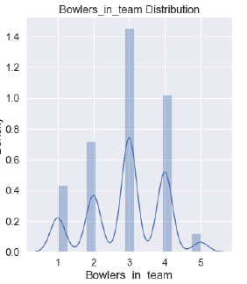
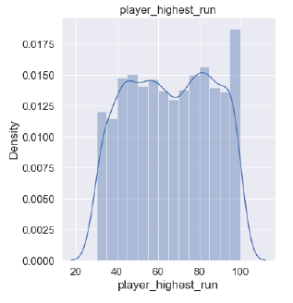
UNIVARIATE ANALYSIS OF DATA
DISTRIBUTION | VARIBALES
Normal distribution | Bowlers_in_team, Wicket_keeper_in_team, player_highest_run
Left skewed | Avg_team_Age, All_rounder_in_team, Max_wicket_taken_1over, Min_run_scored_1over
Right skewed | Audience_number, Extra_bowls_bowled, Min_run_given_1over, Max_run_scored_1over, Max_run_given_1over, extra_bowls_opponent

Slide 9
COUNT PLOTS FOR CATEGORICAL DATA

Slide 10
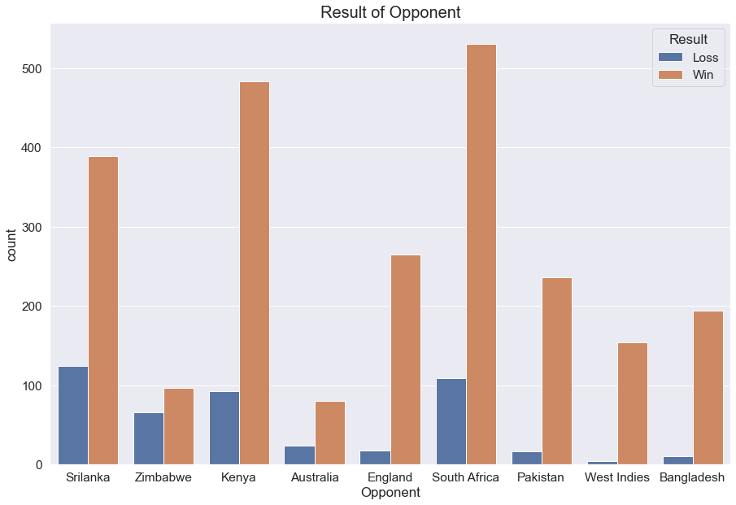
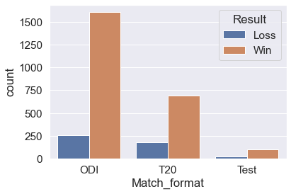
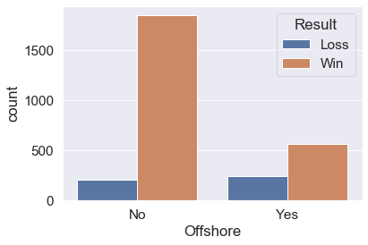
BIVARIATE ANALYSIS OF DATA

Slide 11
CORRELATION OF CONTINUOUS VARIABLES
CORRELATION IS MAXIMUM FOR EXTRA_BOWLS_OPPONENT AND MAX_RUN_GIVEN_1OVER (0.65)

Slide 12
MISSING VALUES
Variables | Before imputaion | After imputaion
Result | 0 | 0
Avg_team_Age | 97 | 0
Match_light_type | 52 | 0
Match_format | 70 | 0
Bowlers_in_team | 82 | 0
Wicket_keeper_in_team | 0 | 0
All_rounder_in_team | 40 | 0
First_selection | 59 | 0
Opponent | 36 | 0
Season | 62 | 0
Audience_number | 81 | 0
Offshore | 64 | 0
Max_run_scored_1over | 28 | 0
Max_wicket_taken_1over | 0 | 0
Extra_bowls_bowled | 29 | 0
Min_run_given_1over | 0 | 0
Min_run_scored_1over | 27 | 0
Max_run_given_1over | 34 | 0
extra_bowls_opponent | 0 | 0
player_highest_run | 28 | 0
Players_scored_zero | 0 | 0
player_highest_wicket | 0 | 0
Total missing values | 789 | 0

Slide 13
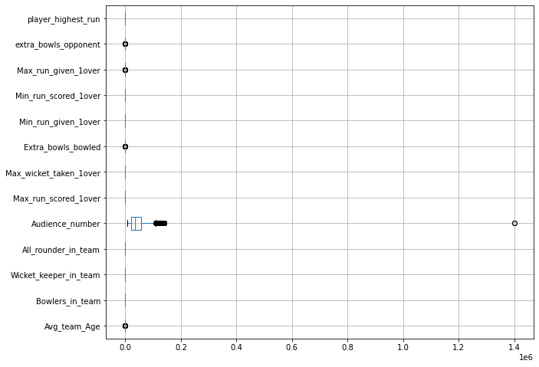
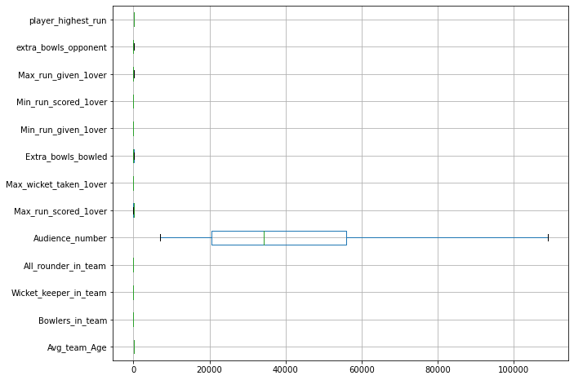
BEFORE OUTLIER TREATMENT
AFTER OUTLIER TREATMENT
AVERAGE TEAM AGE, AUDIENCE NUMBER, EXTRA BOWLS BOWLED, MAXIMUM RUN GIVEN 1OVER, EXTRA BOWLS OPPONENT HAS OUTLIERS WHICH WERE REMOVED.

Slide 14
VARIANCE INFLATION FACTOR
AUDIENCE_NUMBER AND PLAYER_HIGHEST_WICKET
HAS HIGHEST VIF >5.0 AND CAN BE DROPPED

Slide 15
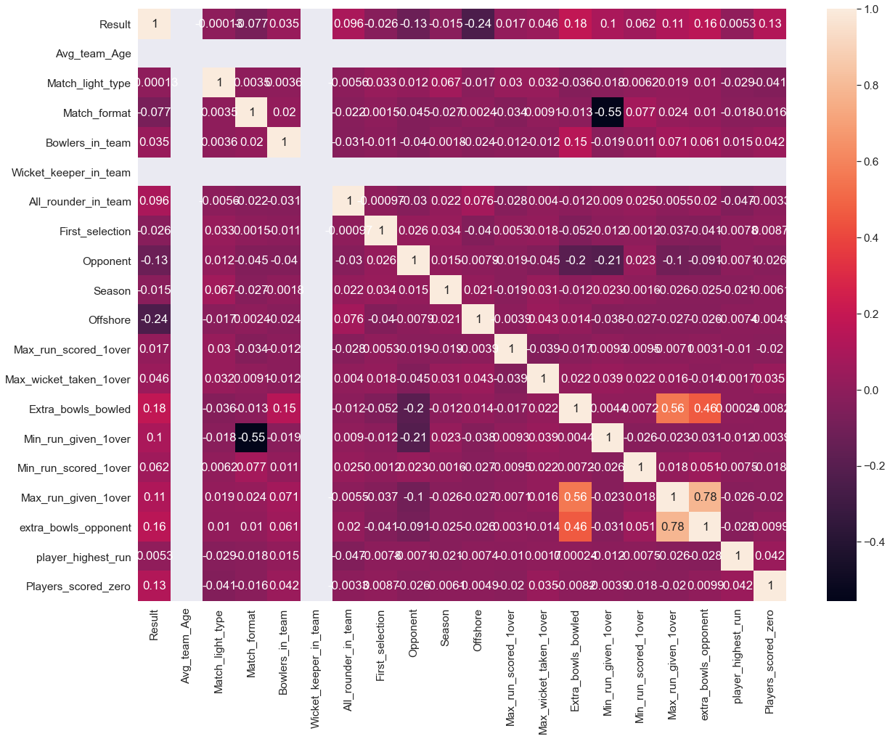
CORRELATION OF DATA AFTER VARIABLE TRANSFORMATION
CORRELATION IS MAXIMUM FOR EXTRA_BOWLS_OPPONENT AND MAX_RUN_GIVEN_1OVER (0.78)

Slide 16
The data of the target variable is unbalanced as it depicts target variable=1 for 83.8%(win) of the cases and 16.2% (loss)for target variable=0.
CLUSTERING
CLUSTERING WAS DONE AND THREE DIFFERENT MATCH FORMATS OF ODI, T20 AND TEST ARE CONSIDERED TO DEVELOP MODELS

Slide 17
MODEL BUILDING
FOR OVERALL DATA SET DIFFERENT MODELS MENTIONED BELOW ARE BUILD
DECISION TREE CLASSIFIER (DTC)
RANDOM FOREST CLASSIFIER (RFC)
NEURAL NETWORK CLASSIFIER (NNC)
LOGISTIC REGRESSION (LOG REG)
LINEAR DISCRIMINANT ANALYSIS (LDA)
NAÏVE BAYES WITH SMORE (NBS)
KNN WITH SMOTE (KMMS)
MATCH FORMAT | MODELS BUILD
ODI MATCH | RANDOM FOREST CLASSIFIER (RFC) NEURAL NETWORK CLASSIFIER (NNC)
T20 MATCH | RANDOM FOREST CLASSIFIER (RFC) NEURAL NETWORK CLASSIFIER (NNC) KNN WITH SMOTE (KMMS)
TEST MATCH | LOGISTIC REGRESSION (LOG REG) NEURAL NETWORK CLASSIFIER (NNC)

Slide 18
PERFORMANCE METRICS OF DIFFERENT MODELS BUILD FOR OVERALL DATA

Slide 19
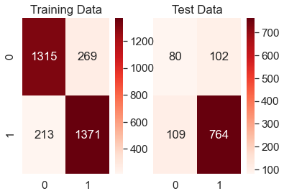
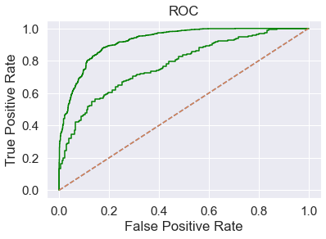
MODEL EVALUATION OF DIFFERENT MODELS BUILD FOR OVERALL DATA
INTERPREATION:
RANDOM FOREST CLASSIFIER IS THE BEST MODEL BUILD ON ENTIRE DATASET.
VARIABLE IMPORTANCE OF 0.1 CAN BE CONSIDERED FOR DEFINING STRATEGIES TO WIN

Slide 20
PERFORMANCE METRICS OF DIFFERENT MODELS BUILD FOR DIFFERENT CLUSTERS

Slide 21
PERFORMANCE METRICS OF DIFFERENT MODELS AFTER MODEL TUNING FOR DIFFERENT CLUSTERS

Slide 22
STRATEGY FOR WINNING TEST MATCH

Slide 23
BUSINESS RECOMMENDATIONS FOR WINNING TEST MATCH
RECOMMENDATION-1
India has to opt to bowl first on the offshore match at England if it wins toss. Inning extras must be reduced during the bowling half by the Indian team. Bowlers with little economy rate need to selected as they provide less runs per over to the opponent team.
If India bats first, based on rainy climate, as there is a chance of DLS, maintaining good runs per over (r. p. o) is necessary. Also, after rains, the second batting becomes tougher. As England pitches are bouncy, selecting more (4 allrounders) and minimising duck-outs i.e., by sending opening batsmen who can stand for a long time at least 20 overs. Maintaining partnerships (at least 2-3) of 100- 120 runs and average of 4-5 runs per over is highly appreciated in the match.
Practice matches are also preferred as it helps to acclamatise to the offshore climatic conditions at England since no test matches were played with Europe in rainy season based on the dataset.

Slide 24
STRATEGY FOR WINNING T20 MATCH

Slide 25
BUSINESS RECOMMENDATIONS FOR WINNING T20 MATCH
RECOMMENDATION-1
The players must score minimum of 20 runs and no duck-out is mandatory for winning. So, the captain must deploy scoring batsmen as openers, select 3-4 allrounders in team and one all-rounder in the top 4 batting line-up. The runs per over by the team must be maintained around 8-9 at least if batting first.
The match at times due to fog in winter, the ball becomes slippery and can’t slide on ground. So, it is advisable to bat first as Australia is a tough team.
RECOMMENDATION-2
Consider the bowling strategy, it is necessary to minimise the inning extras and pressurise the opponent team by taking key wickets, especially in P1 and P2. The mid overs are to be controlled by spinners and allrounders. More allrounders are generally preferred as in T20 matches, scores fly high.

Slide 26
STRATEGY FOR WINNING ODI MATCH

Slide 27
BUSINESS RECOMMENDATIONS FOR WINNING ODI MATCH
RECOMMENDATION 1
Provide less bowling extras during the bowling innings. Fast bowlers during the P1 and P3 with good swing are to be selected in the team.
Minimising the opponent runs per over by taking more wickets by selecting excellent spinners with less economy rate.
RECOMMENDATION 2
Selecting 2-3 all-rounders in the team and opt to bat first, if India wins toss due to hard pitch, foggy conditions in the second innings.
Maximum runs must be scored per over if India bats first.
THANK YOU

